Slide 1
Surrealist Sculpture
Surrealism- a 20th century avant-garde movement in art that sought to release the creative potential of the unconscious mind, for example by the irrational juxtaposition of images.
Surreal: Dreamlike quality, unreal, fantastic
GOALS:
*Realistic Color and Details
*Two ideas combined into one
*Stands on its own
*Is non functional (not used for anything)
*Concept choice is explained on grading rubric

Slide 2
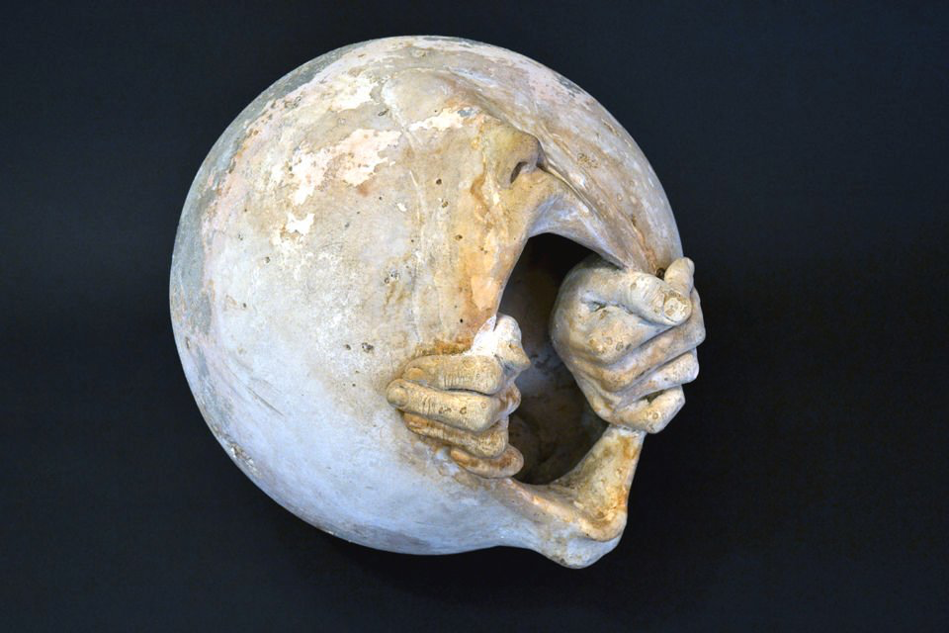
Surrealist Moon- Richard Etts

Slide 3
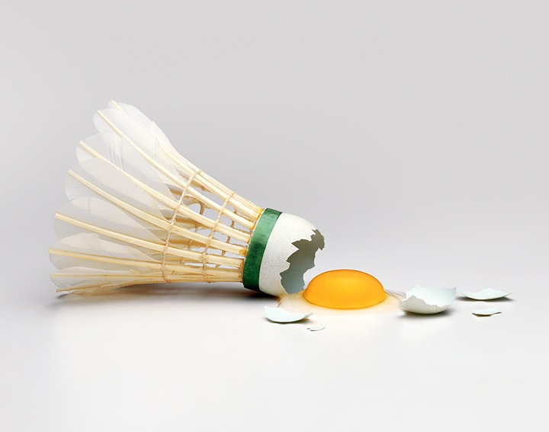
Use any material introduced in class, I recommend clay.

Slide 4
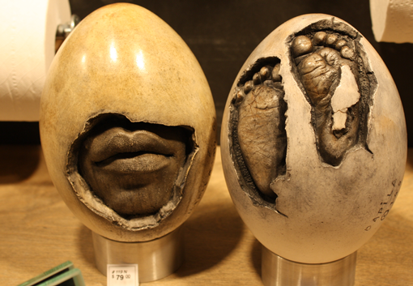
Jen Selk

Slide 5
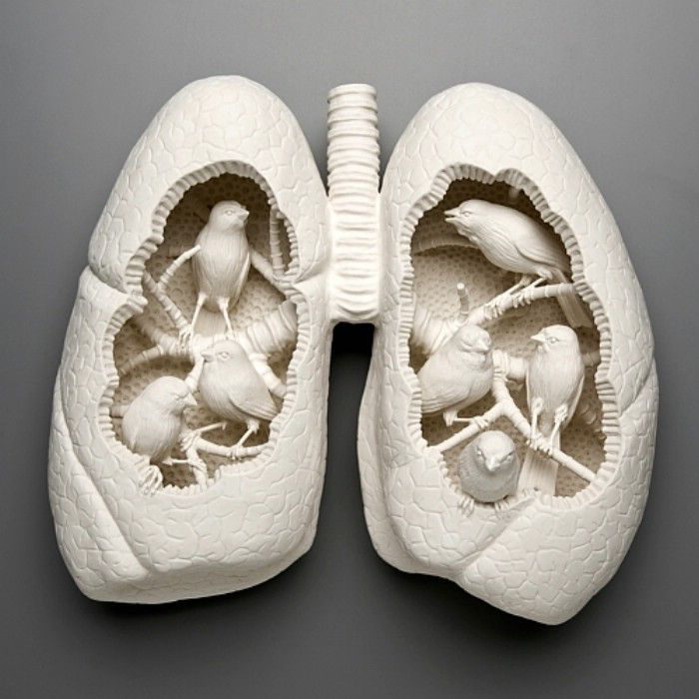
http://www.katemacdowell.com/portfolio.html

Slide 6
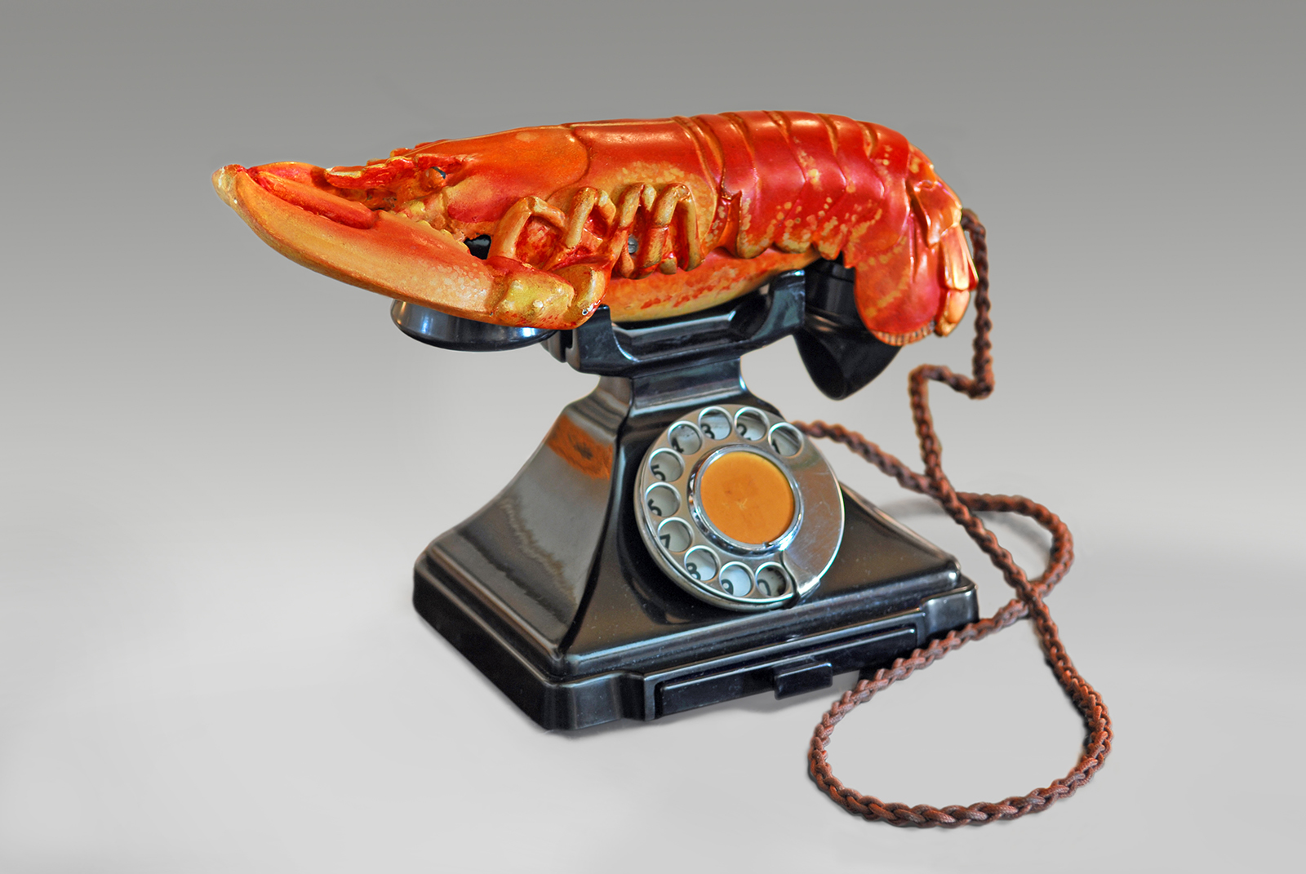
Salvador Dali “Lobster Telephone” 1938

Slide 7
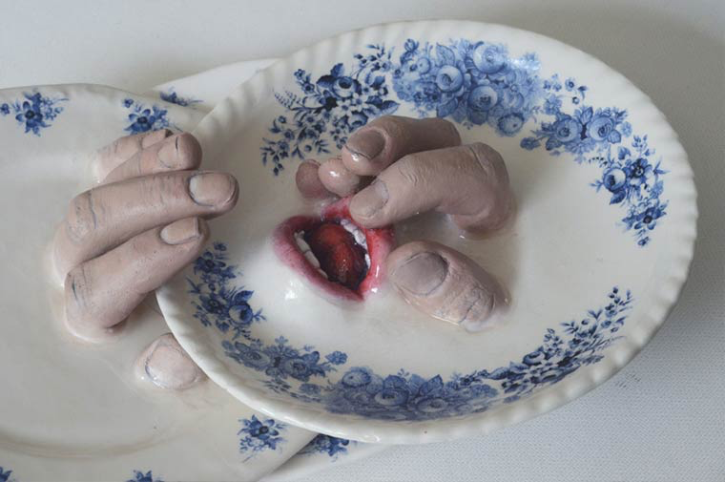
Ronit Baranga

Slide 8
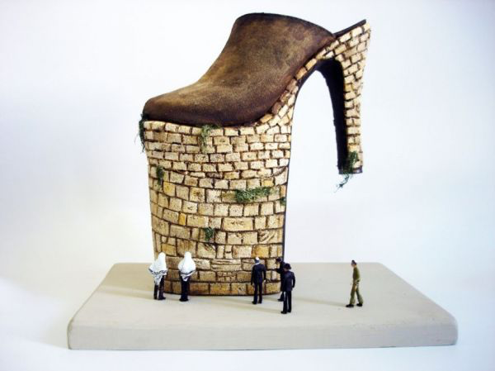
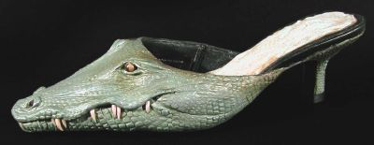
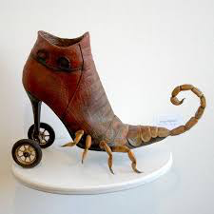
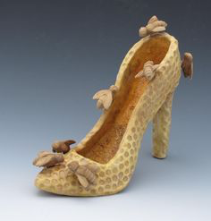
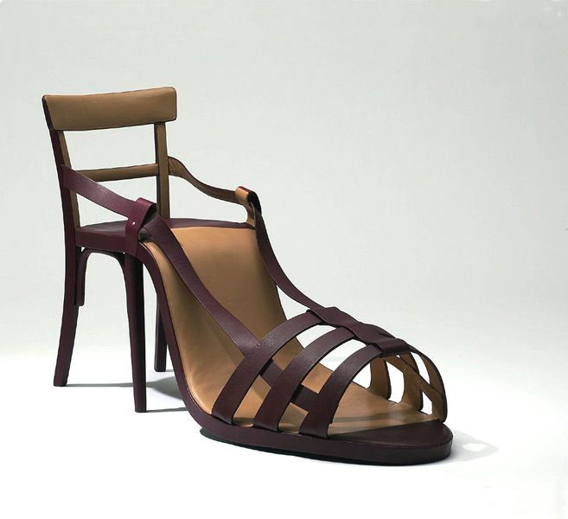
If you are having trouble with your idea, use a shoe for one of your 2 ideas.

Slide 9
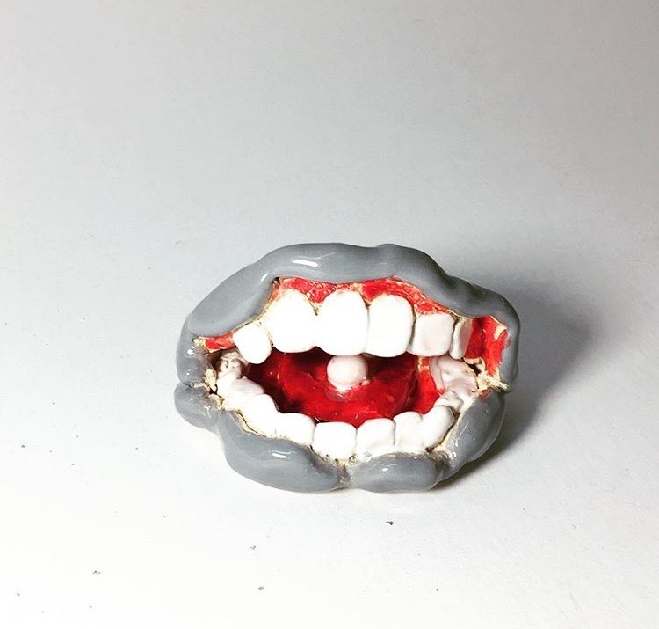

Slide 10
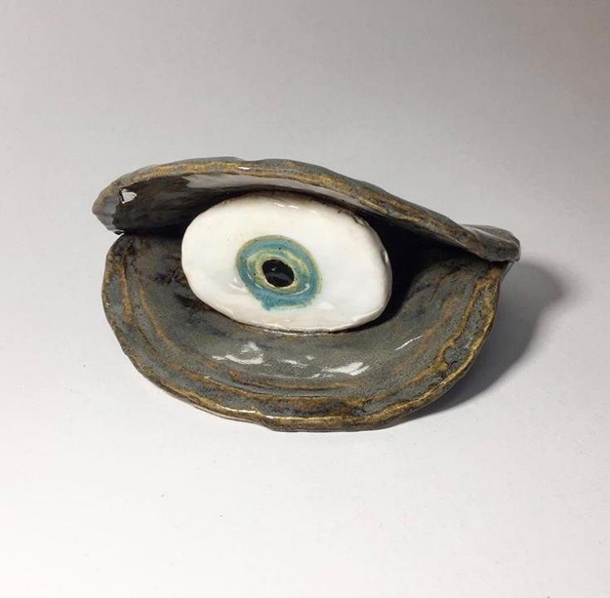

Slide 11
